Slide 1
DECO3500 DESIGN PROPOSAL
Push n Pray
Serendipitous connections on campus
Ruby, Reyana, Bianca, Emily, Ellie
Notes:
Hi we’re team Push n Pray. Our team strengths include clear communication, attention to detail, creativity and passion. Our domain space is serendipitous connections on campus.

Slide 2
Team intro and strengths
Leadership and team players
Design and engineering
Tool exposure
Creative design skills alongside implementation skills
Figma and Canva for design, GitHub and React for build
A mix of both, so the work gets driven and shared
HCI fundamentals
Access to our audience
Organisation and documentation
All of us understand the concepts this project needs
We are on campus with the UQ students we are designing for
Minutes, agendas and studio notes shared, plus bi-weekly meetings
Notes:
Technical vs non technical skill sets
We have a mix of leadership, and team players. Creative design and engineering skills. With a high exposure to creative tools like Figma, Canva and implementation tools like github and react. All of us understand the fundamental concepts of HCI necessary for completing this project. We have high accessibility to our intended audience, on campus UQ students. Not to mention, a rigorous organisation and documentation system. Meeting minutes, agendas and studio notes are taken and shared with everyone alongside bi-weekly meetings. Overall, we believe we are suitable to work on this domain space.

Slide 3
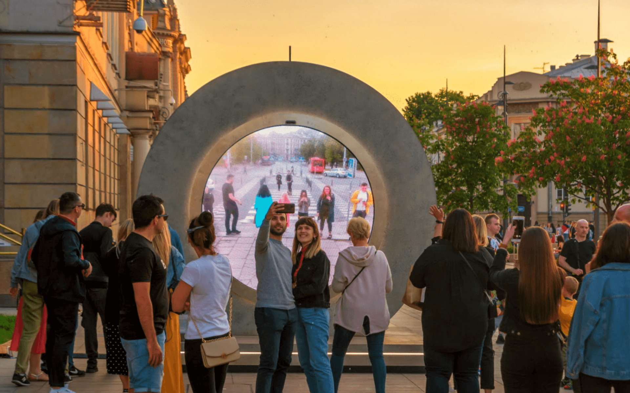
Serendipitous connections on campus
INITIAL IDEATION
NEXT2YOU (Paasovaara et al., 2016)
Started with: low-stakes networking through shared interests
Inspired by: public art installations that spark novel interactions between strangers, e.g. the Portal project (live video links connecting people across cities)
Shift: moved away from interest-based matching toward the serendipitous side, unplanned, chance encounters rather than deliberate networking
Landed on domain: serendipitous connections on campus
Sparks face-to-face interaction between strangers who are regularly in close physical proximity.
Progressive disclosure lowers the social risk of approaching strangers.
SKETCHING WITH STRANGERS (Åkerman et al., 2010)
Two nightclubs linked by interactive tables. Strangers with no shared space still wanted to connect.
Strangers only share situational context (same campus) → how do we spark engagement, then give people a safe, low-effort way to act on it?
Notes:
Our initial domain focused on students finding low-stakes networking opportunities through mutual hobbies and shared passions. But as we dug deeper into ideation, our direction started to pivot. We took inspiration from public art installations like the Portals those live video feeds connecting people in different cities across the globe. What really stood out to us was how those installations spark connection without needing any prior common interest. Just being there, in that specific moment, was a good enough reason for people to start interacting.
That shift really changed how we looked at the problem. Instead of forcing connections based on similarity, we got excited about the serendipitous side of things, those unplanned, spontaneous moments that feel organic rather than curated. This led us to our final domain space: serendipitous connections on campus. We want to foster those genuine, low-pressure encounters between university strangers who might otherwise never cross paths.
Building on that domain, we looked into prior attempts that have tackled a similar experience, and used what we found, alongside our own interviews, to analyse the design opportunities available.
One prior attempt we looked at is Sketching with Strangers. Researchers built two interactive tables and installed them in two separate venues that shared a similar demographic and social energy to a university campus, with young adults, socially open, comfortable engaging with novelty in a shared public space. The tables let people at each location communicate with each other through shared drawings and symbols. This shows that our chosen domain is a genuine space, where people are actually wanting to connect with complete strangers they’d usually never interact with. However, this also reveals a gap, which was also noticed in our interviews. Across our interviews, a clear pattern emerged, where students genuinely want more of these spontaneous connections, but consistently feel like something's missing that stops it from happening. Several participants told us that they would need some kind of excuse or reason to start interacting with a stranger.
Another prior attempt is Next2You, a concept mobile app that aims to spark face-to-face interaction between strangers who are regularly in close physical proximity to each other, for example, taking the same bus or eating at the same cafe. It goes through three levels of interaction, starting at ‘whispers’ which contain any information the users want to share, like attitudes or personal facts, which then progress to messaging, and then finally face-to-face interaction. The paper found that progressive disclosure lowers the social risk of directly approaching strangers, taking pressure off social interactions.
Preliminary interviews found that students on campus do want to connect with strangers and wished they had the courage to. We also found that students had positive associations with anonymous messages left behind on campus. One participant described a window at the Priestly Building where people were writing notes and to do lists, with other people interacting and leaving responses. They found it interesting that students were keeping the thread going while staying anonymous.
Together, this research pointed us toward a specific gap that our concept is aiming to fill, which is rather than leaving connection to chance or relying on unstructured channel like Sketching with Strangers did, we’re proposing a genuine and spontaneous reason for students to engage with someone they’d never otherwise cross paths with.

Slide 4
Design opportunities and concepts
Synchronous
Asynchronous
Co-located
“Whispers” notifying students when repeatedly next to the same person, e.g. in the same lecture theatre row
Messages left behind for the next person to sit at the table
Distributed
A real-time voice connection between two students on opposite sides of campus
Weekly digest showing students that they've unknowingly crossed paths with X people Y times in a week, with the option to meet up
Notes:
These are some design opportunities we’ve identified based on our primary and secondary research organised in a time-space matrix. We also employed this probe to collect data based on the concept of connecting students via a location-tied message left for the next person who sits in the same seat or table in a lecture theatre, library, or other similar places. We left a simple sheet of paper with the prompt, 'Leave a message for the next person!' on the library printer. We wanted to see whether students would actually engage with an anonymous, asynchronous prompt like this, without any instructions beyond that one line. What stood out most was that none of this needed any structure, just a low-stakes, visible invitation was enough for students to leave something behind, and for other students to notice and respond, sometimes offering support, sometimes just adding to the fun. This directly reinforces the interview finding we mentioned earlier, students don't need an elaborate mechanism to connect, they just need a visible, easy opening.These opportunities differ from the existing solutions they draw upon as they have been designed with our intended audience, on-campus university students, in mind.

Slide 5
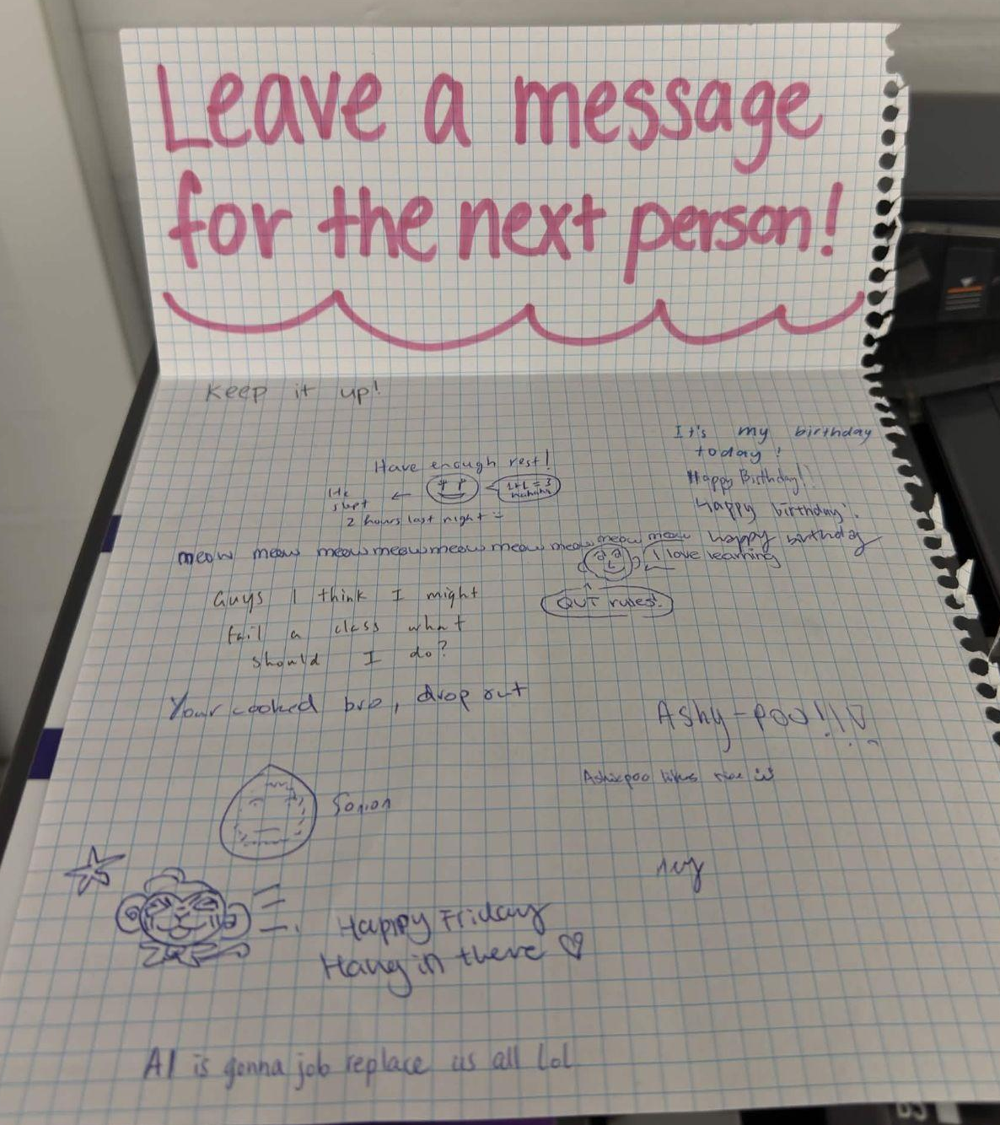
Quotes from our domain owners:
"I think having those spurts of randomness in your life... could make a really regulated, bland life a bit spicier."
"There just aren't enough excuses to actually talk to people."
"I wish everyone was more open to socialising."
"I like to learn more about people. I like to make new friends."
Intended audience
University students in Brisbane, 18 plus, on campus and interacting face to face
VALUES
Curiosity and spontaneity, kept low stakes and playful
SKILLS
Quick to pick up new social tools
Probe on Campus:
WORKFLOWS
Pockets of downtime between lectures and study
PRIORITIES
Belonging without commitment, on their own terms
Notes:
Our intended audience is university students in Brisbane, 18 plus, who are on campus and interacting face to face.
What really drives them, based on our research, is curiosity and spontaneity. They like novelty, they like unplanned moments that break up the day. But it has to feel low stakes, playful, and not like a performance. Research shows that privacy matters a lot too, they want to control how much of themselves they reveal and how fast. What they're really after is belonging without commitment.
Day to day, they're juggling lectures and study with little pockets of downtime in between, and most are used to picking up new social tools pretty fast. Their priority would be making genuine, low pressure connections without it eating into time they don't have.
Our concept tries to bridge the gap between turning those in between campus moments into real, serendipitous encounters.

Slide 6
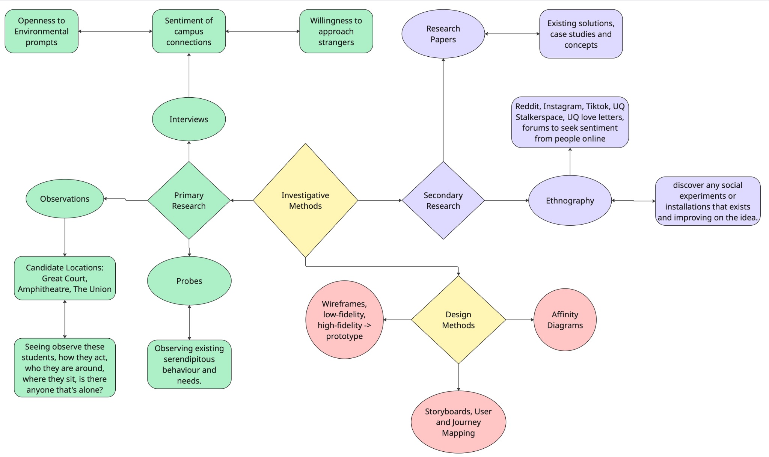
Plan of work
What we still need to find out and how we'll investigate it
Notes:
As we continue to narrow between our design opportunities, we plan to validate using a mix of primary and secondary research.
Firstly, we will use semi-structured interviews with students to understand why they do or don't feel connected on campus, uncover the current landscape of making friends and to test reactions to the early concepts of our phone idea. Secondly, we plan to use more probes such as message walls around campus to understand student’s emotional needs and motivations for spontaneous interactions. Thirdly, we will run observations at a few candidate locations such as the Great Court, the Amphitheatre or the Union to see where students pause, interact, linger and make contact, which can tell us where a trigger could work.
On the secondary research side we will continue to explore solutions through digital ethnography of reddit, UQ Stalkerspace/UQ love letters or any social media to discover any universal sentiment around wanting to find more serendipity on campus, explore any past installations or social experiments on campuses around the world to further improve our ideas.
Later, we plan to design our solution through design techniques such as affinity mapping, storyboarding, user and journey flows and low-to-high fidelity screens to build towards our final prototype. Thank you.

